Slide 1


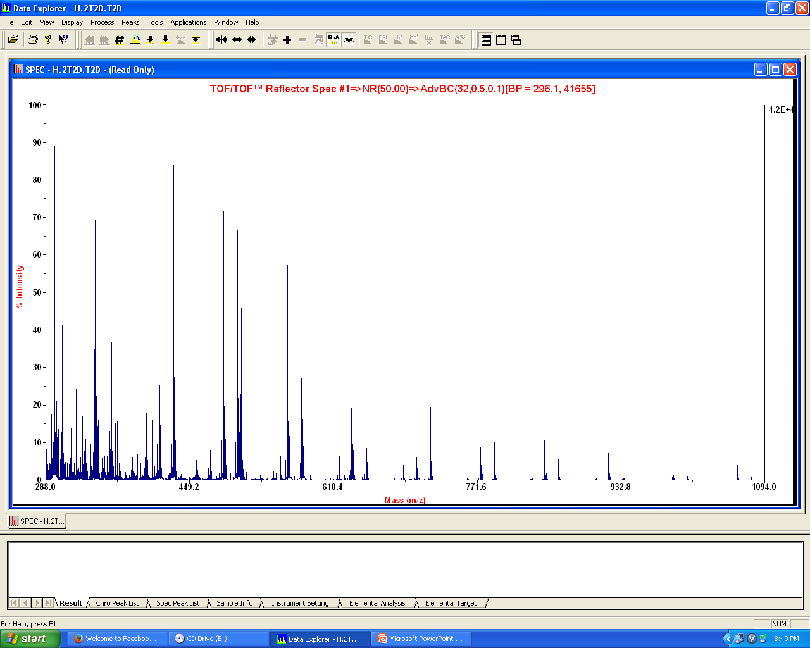
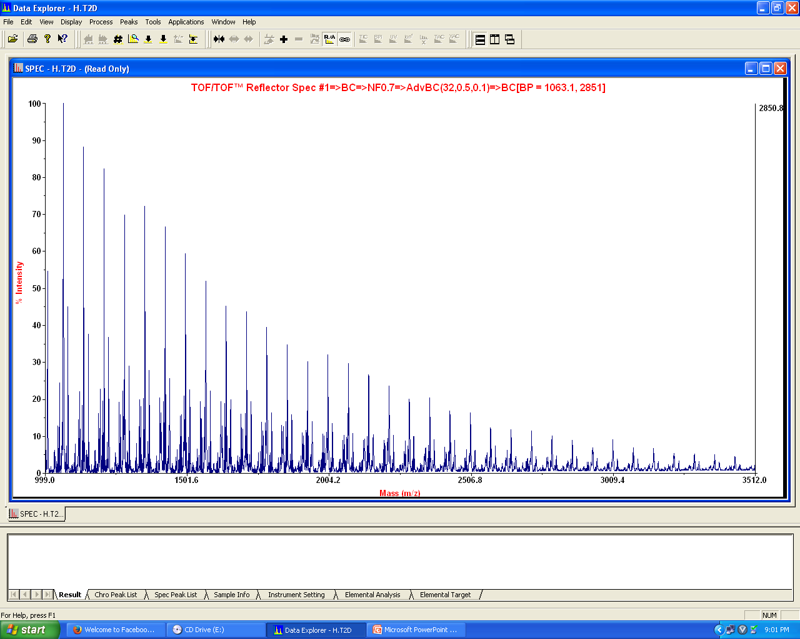
High molecular weight Poly(L-Lactic acid)s and their copolymers by polycondensation: Is it Possible ?
Yogesh R. Nevare, Bhaskar B. Idage, Susheela B. Idage, Swaminathan Sivaram*
Polymer Science and Engineering Division,
National Chemical Laboratory, Pune – 411 008
Email: s.sivaram@ncl.res.in; yr.nevare@ncl.res.in
Objectives
High molecular weight poly (L-(+)-lactic acid)s are generally prepared by ROP of cyclic dimer, L-lactide, which is a crystalline solid. This involves conversion of an aqueous solution of L-lactic acid to a dimer, followed by its purification and polymerization.
It would be desirable to have a non aqueous precursor to poly(L-lactic acid), which is relatively less volatile and is capable of efficient step growth polymerization.
Simple alkyl esters of L-(+)-Lactic acid are not very useful because of their high volatility under conditions normally employed for step growth reactions.
Such a monomer or precursor will also enable synthesis of copolymers of L-lactic acid/esters with α, ω-hydroxyl ester compounds, many of which are naturally available.
Synthesis
Structure and composition of 1
M. Vert et. al.; Macromolecules, 29, 3535 (1996).
d, g
b
h, i
e
Synthesis of a novel AB precursor for preparation of Poly(l-lactic acid ester)s.
c, f, j
d, g
b
a
Structure and composition of 2
h, i, e
d, g
b
¹H NMR Spectrum of 1 in DMSO-d₆.
h, i
e
L-(+)-lactic acid, commercial procured, is a mixture of monomer and higher oligomers with an DP=1.45.
d, g
b
c, f, j
a
Structure and composition of 3
h, i
e
¹H NMR Spectrum of 2 in DMSO-d₆ .
Aqueous L-(+)-lactic acid can be extracted into a CH₂Cl₂ solution. The organic solution of L-(+)-lactic acid has DP= 1.76.
Structure and composition of 4
h’ i’ e’
Tc
k’
d’ g’
b’
Tg
k’
h’ i’ e’
h’ i’ e’
d’ g’
b’
c’ f’ j’
h’ i’
k’
d’ g’
Tm
e’
b’
k’
d’ g’
c’ f’ j’
b’
a’
¹H NMR Spectrum of 4 in DMSO-d₆.
DSC thermogram of 4.
¹H NMR Spectrum of 3 in DMSO-d₆ (DP= 4.75).
5mer
14mer
Formation of the AB precursor with a DP= 2.33 which confirming the addition of 1 methyl lactate unit.
6mer
15mer
16mer
18mer
4mer
17mer
19mer
Future work
7mer
20mer
To examine the kinetics of transesterification Vs cyclic dimer formation using 3 as the precursor and comparison with polymerization of aqueous L-lactic acid.
To establish the structure of polymers in terms of composition and end groups.
To examine the effect of structural variation of 3 as relative rates of chain growth and cyclization.
21mer
22mer
8mer
23mer
24mer
25mer
27mer
9mer
26mer
28mer
29mer
30mer
10mer
31mer
34mer
11mer
12mer
13mer
35mer
8mer
41mer
43mer
m/z
MALDI-TOF-MS spectra of 4.
m/z
Acknowledgement
AB precursor 3 undergoes further chain extension under step growth polymerization conditions. However, this is accompanied with the formation of ~ 20 % L-lactide 5.
Mr. Yogesh Nevare is thankful to DST, New Delhi for financial support.
The assistance of Dr. P. R. Rajamohanan, CSIR-NCL for NMR analysis is gratefully acknowledged.

